Slide 1
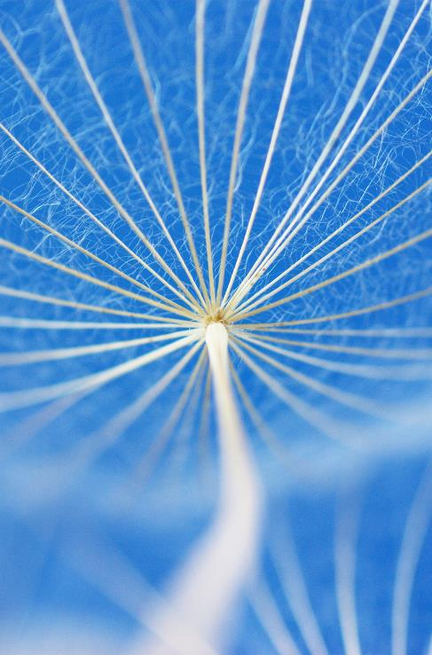
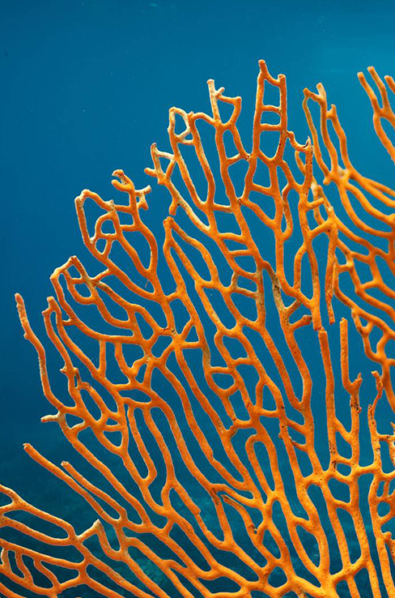
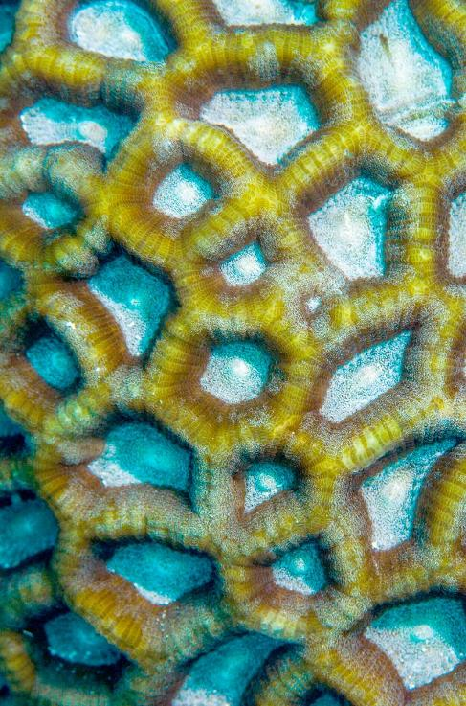
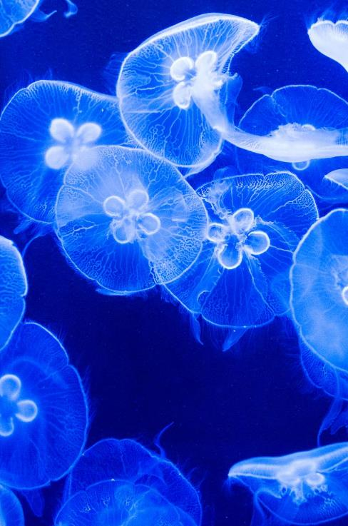
OCEAN ACIDIFICATION
PBL PROJECT (F449 TO F454)

Slide 2
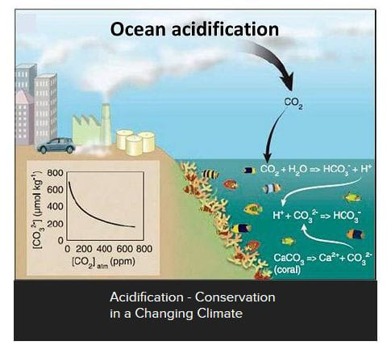
INTRODUCTION
Ocean acidification is a gradual decrease in the PH of Earth’s Ocean primarily caused by the absorption of carbon dioxide(CO2) from the atmosphere.

Slide 3

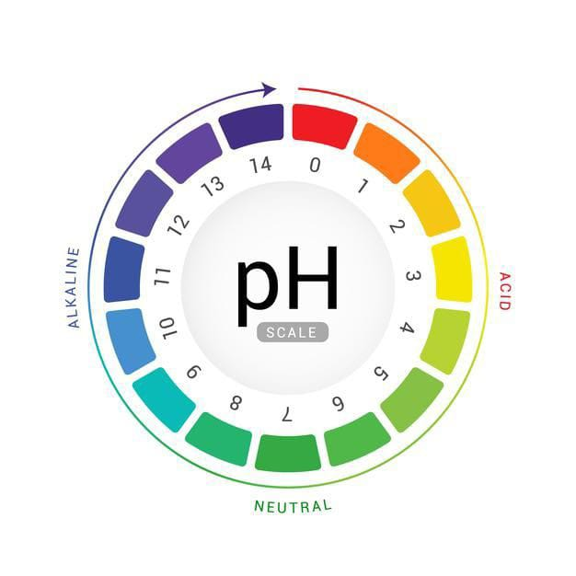
The PH SCALE
The Ph scale runs from 0 to 14,with 7 being a neutral ph. Anything higher than 7 is basic (or alkaline) and anything lower than 7 is acidic.
The ph scale is an inverse of hydrogen ion concentration so more hydrogen ions translates to higher acidity and a lower ph.

Slide 4
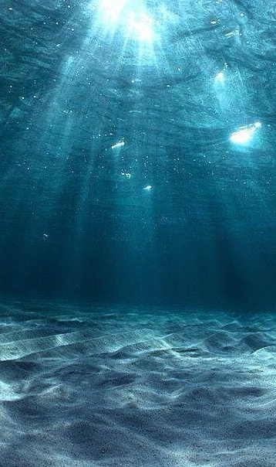
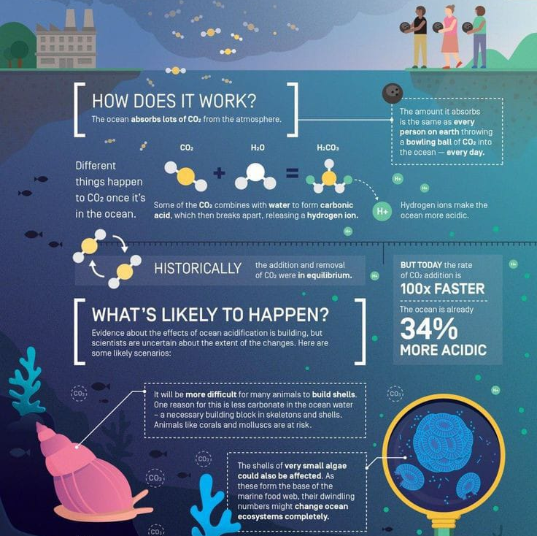
Causes
Carbon Dioxide Absorption: The primary cause of ocean acidification is the increased concentration of CO2 in the atmosphere due to human activities, such as burning fossil fuels and deforestation.
Chemical Reactions: When CO2 dissolves in seawater, it undergoes chemical reactions that produce carbonic acid. This acid dissociates into bicarbonate and hydrogen ions, leading to a decrease in pH.
Carbonate Ion Decrease: The excess hydrogen ions from carbonic acid formation reduce the availability of carbonate ions. Which is crucial for the formation of calcium carbonate, a key component of the skeletons and shells of many marine organisms.

Slide 5
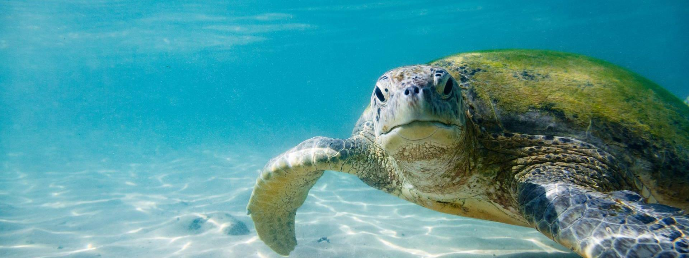
impact of ocean acidification
On aquatic Life and Ecosystem

Slide 6
Impact of ocean acidification on shell builders
-Ocean acidification is already impacting many ocean species especially organism like oysters & corals that make hard shell and skeleton by combining calcium & carbonate from seawater

Slide 7
Coral Bleaching :The decrease in pH and carbonate ions inhibits coral growth and disrupts the symbiotic relationship between corals and algae, leading to coral bleaching and, ultimately, coral death.
Mollusk and Shellfish Vulnerability: Acidification hinders the ability of mollusks and shellfish to build and maintain their shells, making them more susceptible and i environmental stress.
Impact on Food Web: Disruptions in the life cycles of various marine organisms, including plankton, can have cascading effects throughout the marine food web, affecting fish populations and, consequently, fisheries.
Economic Consequences: Fisheries and aquaculture industries that rely on healthy marine ecosystems may suffer economic losses due to declines in productivity and the collapse of valuable fish stocks.
Impact on food web

Slide 8
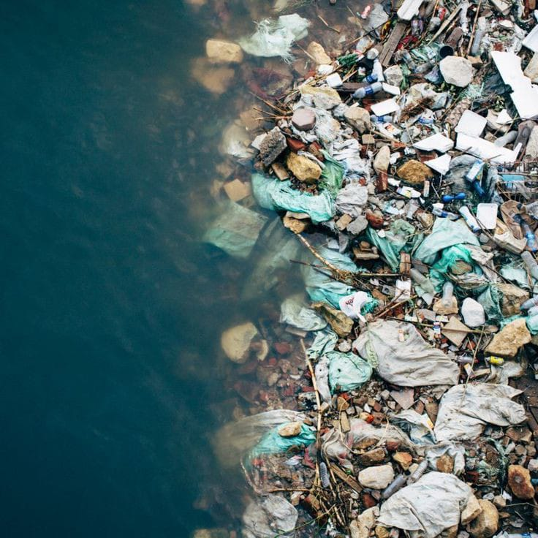
Preventive measures and precautions
So The que is what Can We do for to reduce level of ocean Acidification?
ocean acidification starts from the basic things that we can do like the garbage we produce in our surrounding areas.
Be a smart consumer –
Say ‘No’ to single-use of plastic bags. Do not buy coral products. Follow the principle of ‘Reuse, Recycle & Reduce’.

Slide 9
proper rules for reducing ocean acidification awareness and education –
As ocean acidification is an environmental issue, hence awareness and education can help to save oceans. People need to understand what is going wrong and how it is going wrong. If you know the problem, you will be able to find out the most appropriate solution.
Conserve energy at a personal level –
As carbon dioxide is a major cause of ocean acidification, hence we can minimize the amount of carbon emission in the atmosphere by using less energy at our homes.
Only discussing possible ocean acidification solutions is not enough, and we need to start implementing these solutions to control the acidification problem.

Slide 10
Be a part of a campaign or an organization –
If you are dedicated to saving the environment and want to do something towards this, then you can be a part of environment saving campaigns.
By joining these campaigns, you can also share your ideas about ocean acidification.
Reducing CO2 Emissions: Addressing the root cause of ocean acidification involves global
efforts to reduce CO2 emissions from fossil fuel combustion and deforestation.
Renewable Energy: using renewable energy sources such as solar and wind power, can significantly reduce carbon emissions.

Slide 11
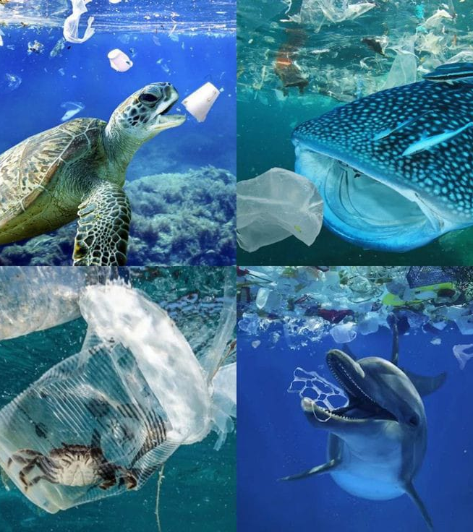
The bottom line
The bottom line is that even if we stop all emissions and work to increase the Earth’s carbon sink capacity ocean acidification will not end immediately.
We can expect to see a lag time before feeling the benefits of our actions.
We can liken it to a car- even if you slam on the breaks the car won’t come to an immediate stop

Slide 12
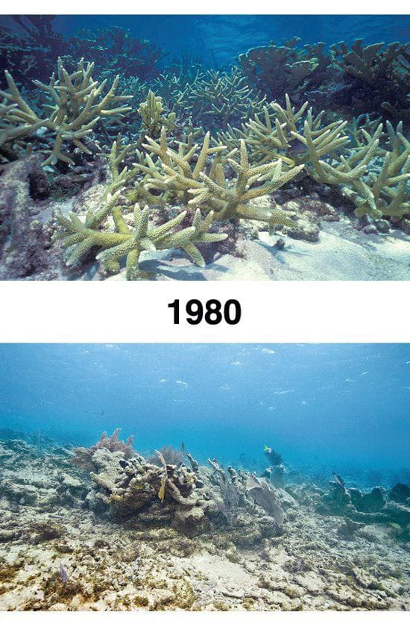
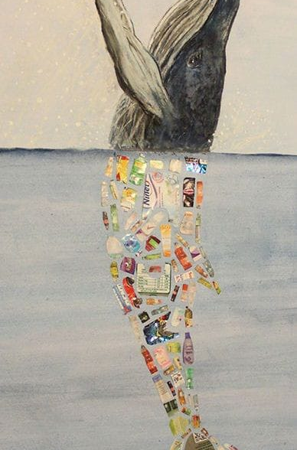
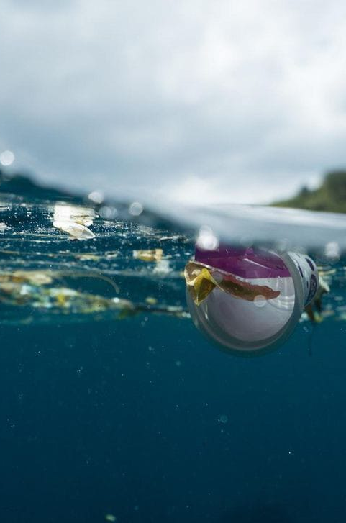
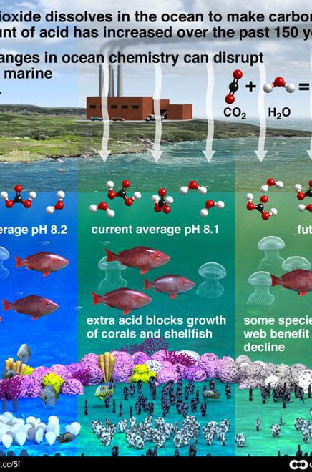
This are some pictures related to ocean acidification
Chief Executive Officer

Slide 13
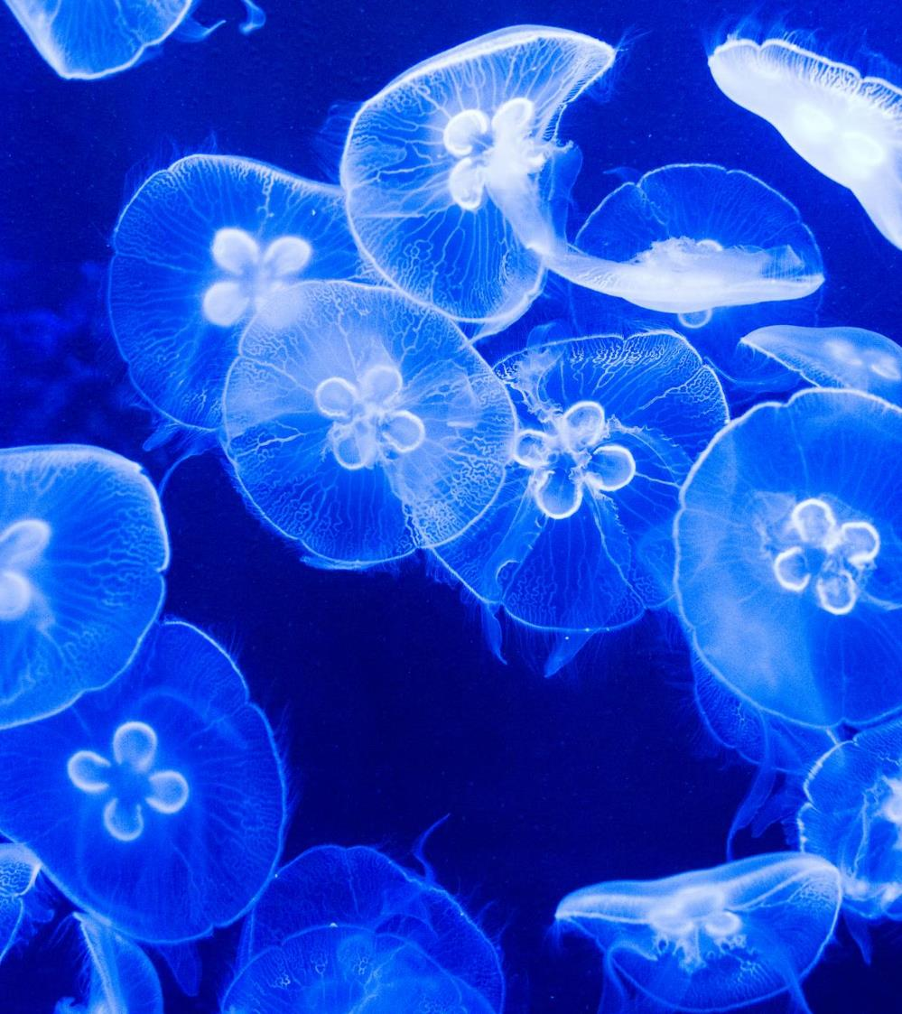
Thank you
Group Leader F450 Payal N Sayyad
F449 Shiva khandekar
F451 Sanskruti Londhe
F452 Sirat Metkari
F453 Atharva Taware
F454 Sameer Khandare
F455 Vedant mahalle

